Slide 1

Impacts of Vehicle, Charger Network, and Driver Behavior Parameters on Regional Transportation Accessibility for Light-Duty Road Vehicles
Aaron Rabinowitz
4/12/2024

Slide 2
Transportation Accessibility
Definition
Transportation Accessibility:
“The ease with which individuals can access opportunities subject to the transportation system in the relevant area”
Transportation Accessibility definitions differ on the following points:
What opportunities to consider?
What transportation options to consider?
What area to consider?

Slide 3
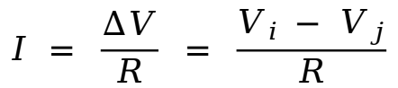
Transportation Accessibility
Circuit Analogy
“The ease with which individuals can access opportunities subject to the transportation system in the relevant area”
Pull Factors
Push factors
Aggregate population movement
$$I = \frac{∆V}{R} = \frac{V_{i }− V_{j}}{R}$$
Traversal difficulty

Slide 4
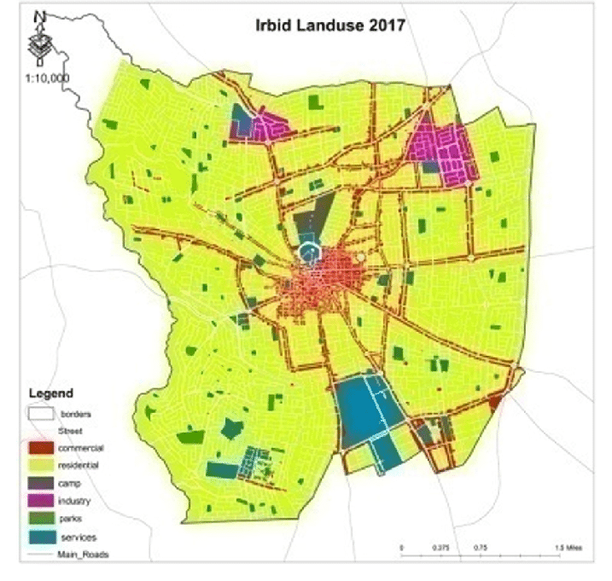
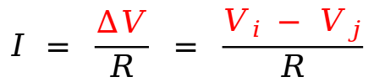
Transportation Accessibility
Overview
Voltage separation is determined by land-use ...
Where are the people?
Where are the jobs?
Where are the stores?
And also by individual preference ...
What type of people live in a given area?
What jobs do these people do?
What stores do they frequent?
And also by temporal availability
When are opportunities open?
When do people desire opportunities?
$$I = \frac{∆V}{R} = \frac{V_{i }− V_{j}}{R}$$

Slide 5
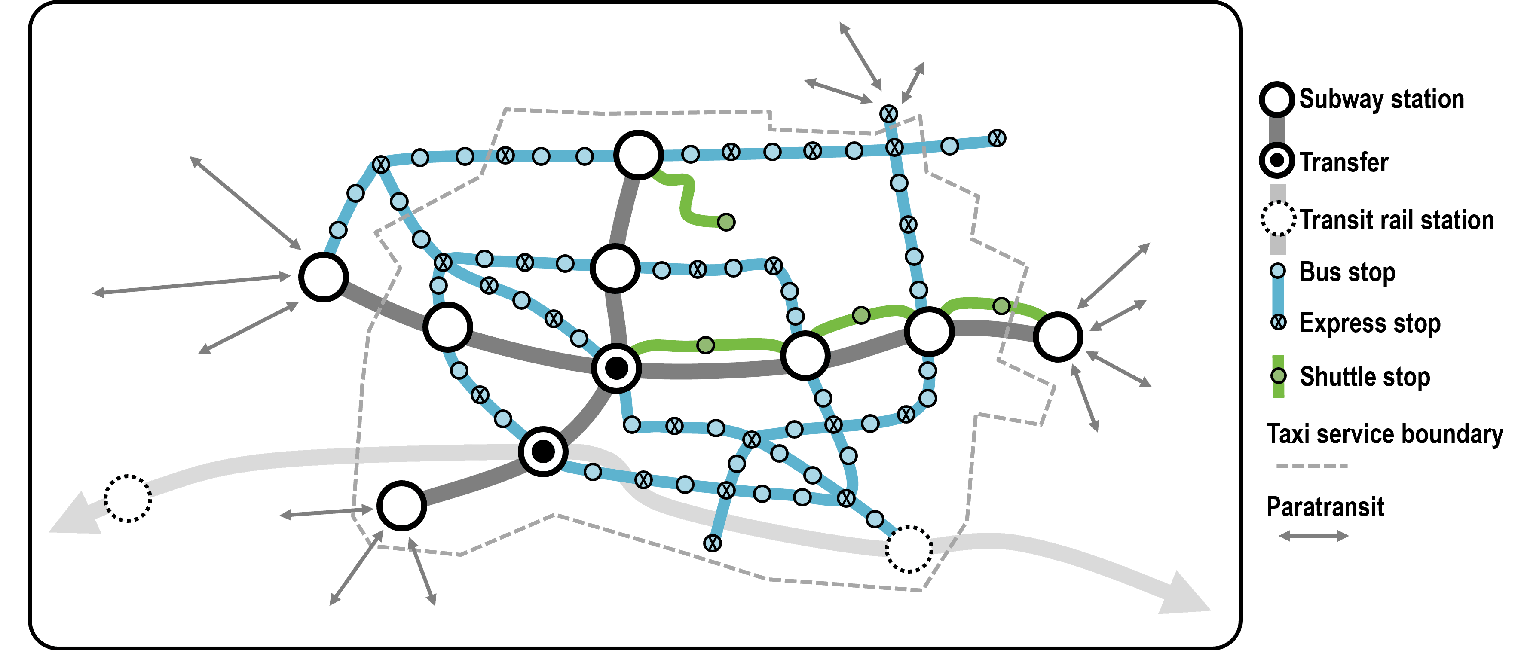
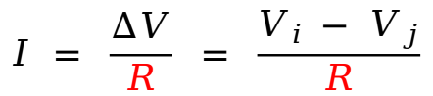
Transportation Accessibility
Overview
Resistance is determined by transportation systems ...
What modes are available?
Where do they go?
How costly are they?
And also by individual preference
Which people prefer which modes?
Why do they prefer those modes?
How much cost will they tolerate?
And also by temporal availability
When are modes available for O/D pairs?
How does service change with time?
$$I = \frac{∆V}{R} = \frac{V_{i }− V_{j}}{R}$$

Slide 6

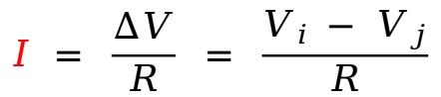
Transportation Accessibility
Overview
A well designed region has coordination between land-use, transportation system, and individual preferences to allow for smooth flow
A poorly designed region will have congested flow with economic, social, and health consequences
Accessibility metrics should, roughly speaking, be flow oriented and encompass:
Land-use
Transportation
Temporality
Individual preference
$$I = \frac{∆V}{R} = \frac{V_{i }− V_{j}}{R}$$

Slide 7
Transportation Accessibility
Methodology
The main subject of debate is how to select opportunities. There are several approaches:
Nearest Proximity: For a given origin and a given set of opportunity categories, pick the closest applicable location in each category.
Isocost: For a given origin and a given set of opportunity categories, draw an isocost polygon centered on the origin on the map and select all applicable opportunities within the polygon.
Gravity/Entropy: For a given origin and a given set of opportunity categories, select all possible applicable locations and performs weighted sum based on proximity and centrality
Discreet Choice: For a given origin and a given set of opportunity categories, use data to model how people actually behave.
The resistance component is universal - shortest paths

Slide 8
Transportation Accessibility
Methodology
Resistance methodology is quite standard
Resistance is a function of the transportation system so thus mode-specific and mixed-mode shortest paths are used
Shortest paths can be computed for any network using well established methods (Dijkstra, Bellman-Ford, etc.)

Slide 9
Road-Trip Accessibility
Background
Modern BEVs have the range to be interchangeable with ICEVs for routine use
With reliable long-dwell charging they can even offer convenience and cost benefits
However, for long road-trips, modern BEVs still lag behind. This is because BEVs have:
Lower maximum ranges
Lower range-addition rates
Less mature supply infrastructure
The longer the trip the more disadvantaged the BEV is. This hinders goals like:
Single ICEV dependence -> single BEV dependence
Mixed household fleets -> BEV only household fleets
Adoption of BEVs by lower income individuals

Slide 10
Road-Trip Accessibility
Background
What is Road-Trip Accessibility:
“The ease with which all important locations within a region can be reached by a given individual using a given road-vehicle”
Land-use: how big is the region and how spread-out are its population centers?
Transportation: Layout of roads and distribution of supply stations
Individual: What are the capabilities of cars driven and how risk tolerant are drivers?
Temporal: Traffic patterns and seasonal infrastructure

Slide 11
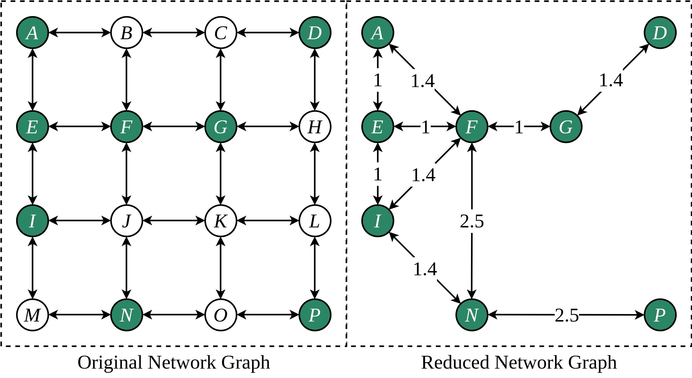
Range-Limited Vehicle Routing
Reduced Sub-Networks
Vehicles which are range limited (all of them) can follow one of two path types for an O/D pair:
Direct path - only available if the traversal range is less than the vehicle range
Indirect path - vehicle stops at an intermediate location to add range
Road vehicles use a common road network but the supply network which determines intermediate locations is fuel specific. The DC EV supply network is neither coincident with nor equivalent to the ICEV supply network.
Both can be represented as Reduced Sub-Network Graphs (RSNG) which retain only possible stop nodes and the network distances between them

Slide 12
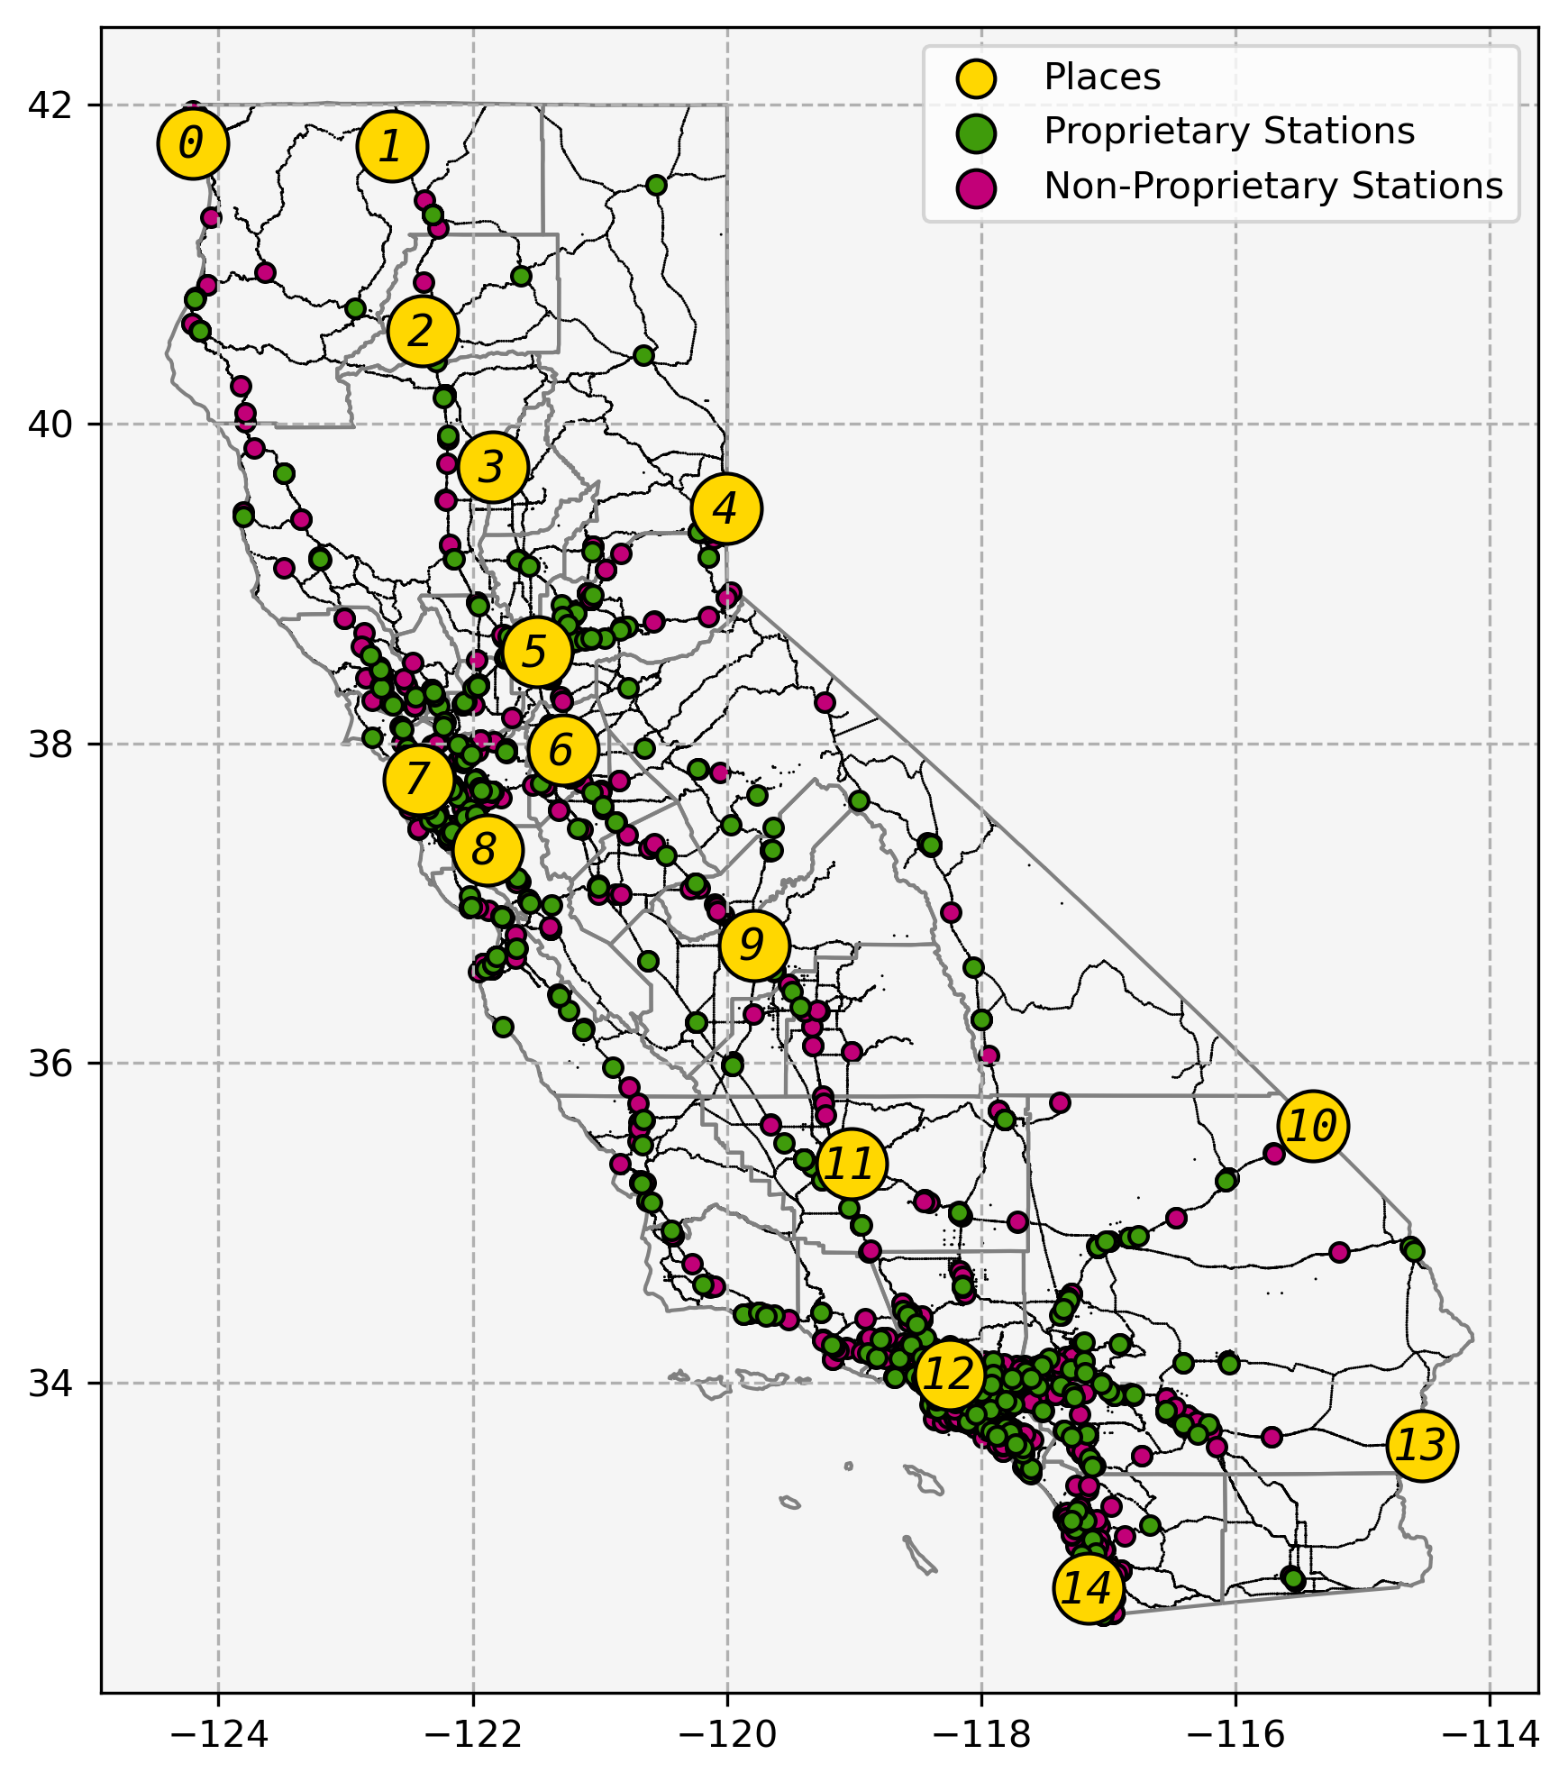
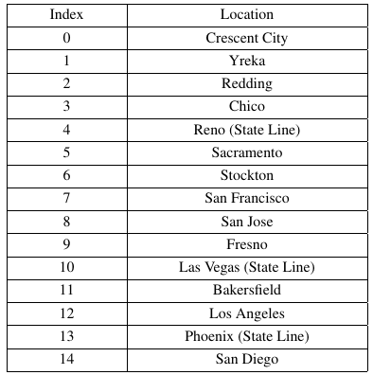
California’s Networks
For purposes of evaluation. The following 15 locations were selected as origins/destinations:
California also contains ~8,000 gas stations and ~1,900 DCFC stations

Slide 13
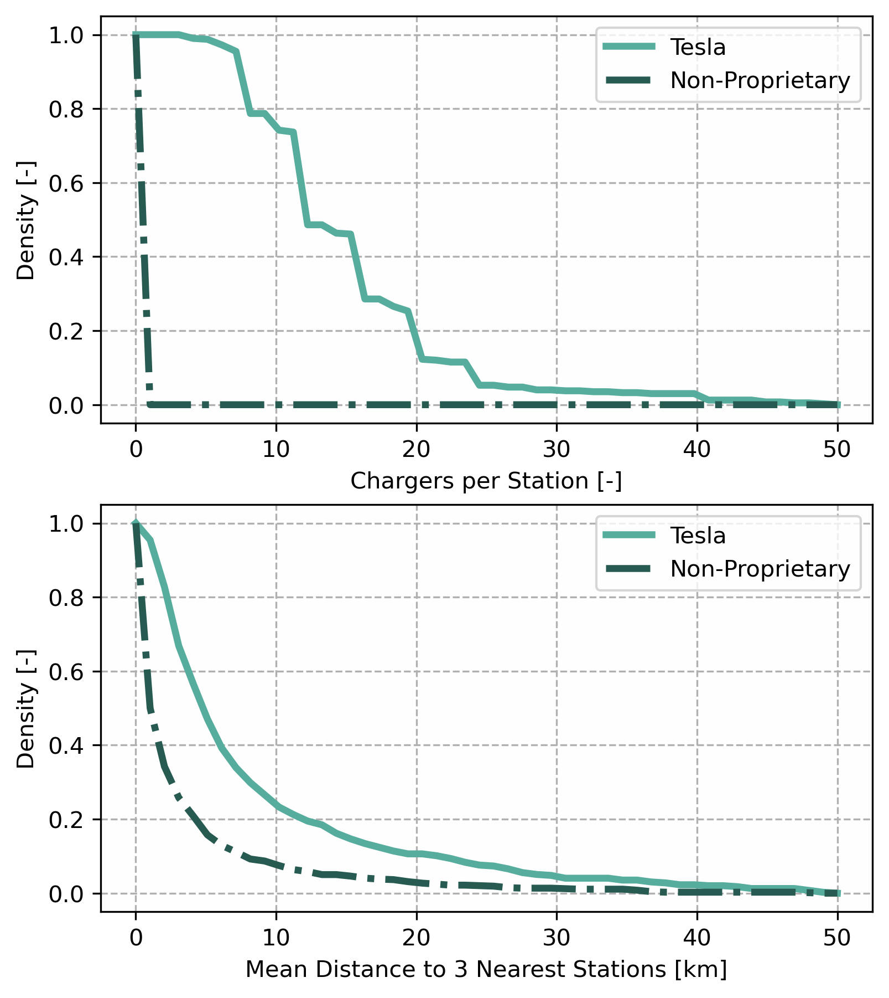
Tesla vs. Everyone Else
Roughly speaking, California’s DCFC stations can be divided in to two networks:
Tesla
Others
These are separate* and unequal networks which lead to unequal experiences
Tesla has 6,277 chargers concentrated in 403 stations
Non-proprietary networks have 3,667 chargers spread among 1,425
Until recently these were fully separate networks

Slide 14
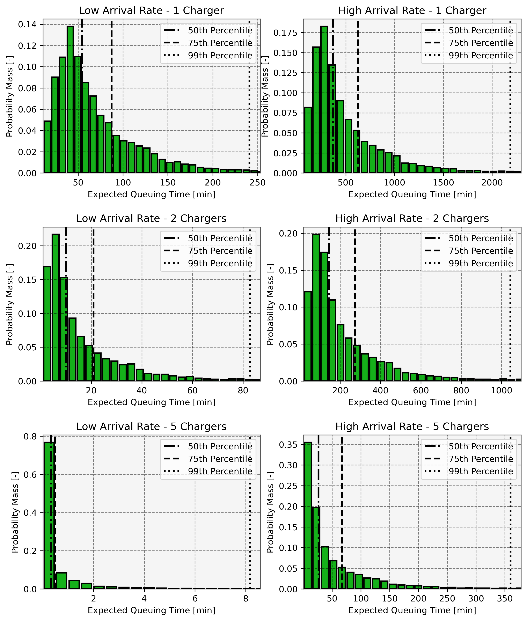
Tesla vs. Everyone Else
Tesla has 6,277 chargers concentrated in 403 stations
Non-proprietary networks have 3,667 chargers spread among 1,425
Both networks provide redundancy which is important because it reduces queuing and increases likelihood of some equipment functionality
Redundancy in networks is a nuanced concept. The Tesla network has redundancy within stations. The non-proprietary networks have redundancy between stations.

Slide 15
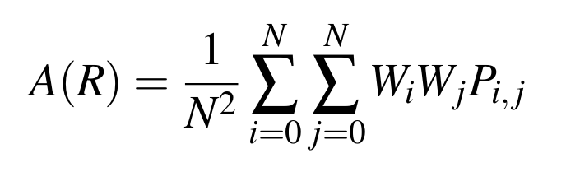
Computing Resistance
For this analysis the metric of resistance is based on time to traverse O/D pairs
A(R) - regional road-trip accessibility
N - number of locations
W -weights for locations (all 1 here)
P - cost (time) for traversal of O/D arc (i, j)

Slide 16
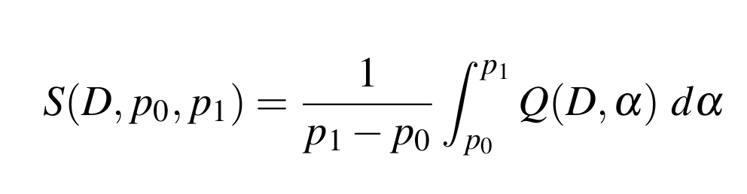
Computing Resistance
P is computed using stochastic Dijkstra routing
Cost allocated for:
Time to drive
Time to charge
Time queuing at charger
Comparison done on the basis of perceived cost:
Perceived cost computed using Superquantile function of observed cost distribution (D) with Aggressive , Neutral, and Cautious settings

Slide 17
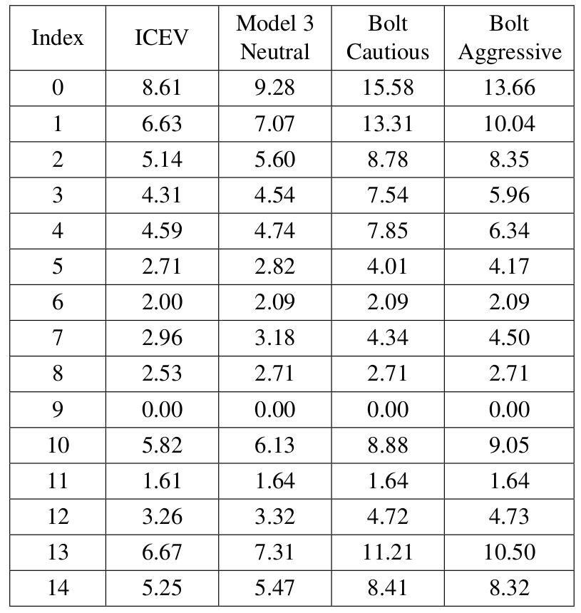
Example
Consider, as an example, the following four scenarios for a
driver based out of Fresno:
Risk neutral driver using a generic ICEV
Takes “direct path”
Risk neutral driver using a Tesla Model 3
High range
High charger reliability
Risk-cautious driver using a Chevrolet Bolt EV
Low range
Low charger reliability
Risk-aggressive driver using a Chevrolet Bolt EV
Low range
Low charger reliability
Hours to traverse

Slide 18
Example
Little difference on short arcs
Hours to traverse

Slide 19
Example
Little difference on short arcs
Major difference on long arcs
Hours to traverse

Slide 20
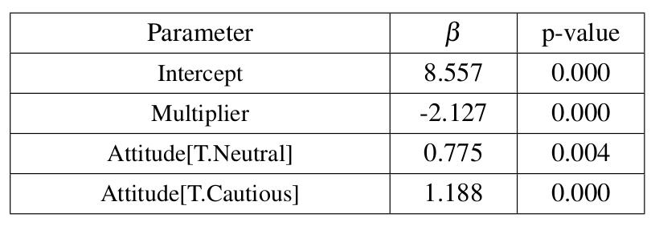
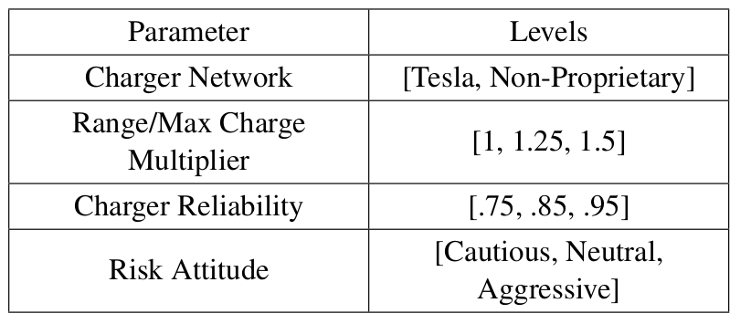

Improving The Delta
So what can be done to make things better?
More vehicle range?
Changes to infrastructure?
People just getting used to it?
Ran a full-factorial on the below parameters for a Bolt using non-proprietary chargers and a Model 3 using Tesla chargers:
Significant parameters (.05) for the Bolt
Significant parameters (.05) for the Model 3

Slide 21
Improving The Delta
Takeaways:
Improving vehicle range matters - fewer charge events is better
People can have a better experience if they accept more risk - may come with time
Improving reliability is less important due to redundancy:
Tesla network has huge redundancy within stations
Non-Tesla networks have some redundancy between stations
Significant parameters (.05) for the Bolt
Significant parameters (.05) for the Model 3

Slide 22
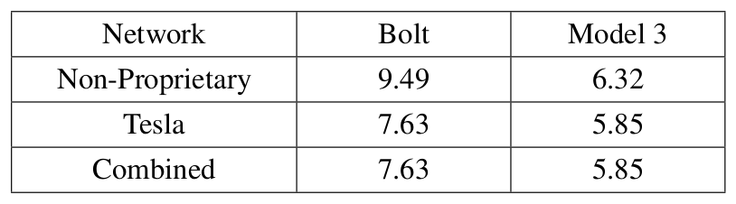
Improving The Delta
Network structure:
So what’s better - more concentrated or more distributed?
Concentration provides immediate redundancy and minimize queuing with perfect information
Distribution provides proximate redundancy with imperfect information
Allowing Bolts to use Tesla chargers is a massive improvement, allowing Model 3s to use non-proprietary chargers isn’t ...
But Tesla also has almost twice the number of ports so more work is needed to answer this

Slide 23

Q & A

